Slide 1

ECE 2700
Digital Circuits
Clocks, Critical Paths,
and C to Gates
Copyright © 2010 Frank Vahid
Instructors of courses requiring Vahid's Digital Design textbook (published by John Wiley and Sons) have permission to modify and use these slides for customary course-related activities, subject to keeping this copyright notice in place and unmodified. These slides may be posted as unanimated pdf versions on publicly-accessible course websites.. PowerPoint source (or pdf with animations) may not be posted to publicly-accessible websites, but may be posted for students on internal protected sites or distributed directly to students by other electronic means. Instructors may make printouts of the slides available to students for a reasonable photocopying charge, without incurring royalties. Any other use requires explicit permission. Instructors may obtain PowerPoint source or obtain special use permissions from Wiley – see http://www.ddvahid.com for information.

Slide 2
Today’s Objectives
To understand how to use a timer to control a high-level state machine
To understand how the clock period is related to RTL design
  To know how to determine the minimum clock period for a given design
    (Maximum clock frequency)
To become familiar with techniques to convert C-like code into an HLSM

Slide 3
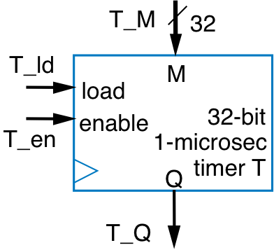
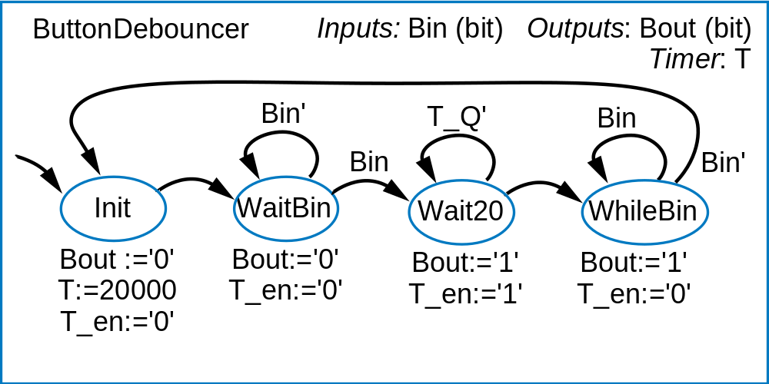
RTL & Timer: Button Debouncing
Press button
  Ideally, output changes to 1
  Actually, output bounces
    Due to mechanical reasons
    Like ball bouncing when dropped to floor
Digital circuit can make actual signal closer to ideal signal
button
B
B
0
1
Ideal:
B
Actual:
B
bounce
T_ld:=‘1’
T_ld:=‘0’

Slide 4
Determining Clock Frequency
Everyone wants the best performance
  High clock frequency
Why can’t we set clock frequency to an arbitrary high number?
  Remember, clock frequency = 1 / clock period

Slide 5
Circuit Delay
Clock frequency limited by longest register-to-register delay
  Or longest input-to-register / output-to-register delay
  Known as critical path
If clock is any faster,
incorrect data may be stored into register
  Longest path on right is 10 ns
  Ignoring wire delays, and register setup and hold times, for simplicity
clk
a
b
10 ns
*
del
a
y
c
Max. clock frequency
= 1 / 10ns
= 100 MHz

Slide 6

Critical Path
Longest path in a circuit
  Dictates maximum clock frequency

Slide 7
Question (AP)
What is the fastest clock frequency for the following circuit? Assume an adder has a delay of 3ns and a shifter has a delay of 2ns
  100 MHz
  200 MHz
  300 MHz
  400 MHz
  500 MHz
1
16
M
16
A
B
Add1: add(16)
16
I
S
Shr1: shiftR1(16)
Dreg_clr
16
Q
Dreg_ld
16
Dctr_clr
clr
I
clr
I
Dctr_ld
ld
Dctr: reg(16)
ld
Dreg: reg(16)
Q
Q
16
D

Slide 8
Critical Path & Wire Delay
Real wires have delay too
  Must include in critical path
Critical path for circuit on
the right is 11ns
Trend
  1980s/1990s: Wire delays were tiny compared to logic delays
  Now: Wire delays may even be greater than logic delays!
Must also provision for setup/hold times, etc…
clk
a
b
0.5 ns
0.5 ns
*
10 ns
0.5 ns
11 ns
11 ns
c

Slide 9

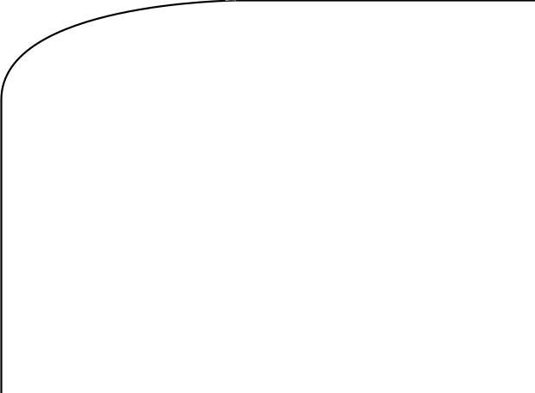

Hard to Find Critical Path In Real Circuits
Several paths can exist
  In the datapath
  In the controller
  Between the
  controller and datapath
  May be
  hundreds or thousands of
  paths
Use automated
tool
s
a
Combinational logic
8
8
d
tot_ld
ld
t
ot_clr
tot
c
clr
tot_lt_s
(
c
)
8
n1
n0
8-bit
8-bit
<
adder
tot_lt_s
8
Datapath
s1
s0
clk
(
b
)
(
a
)
State register

Slide 10
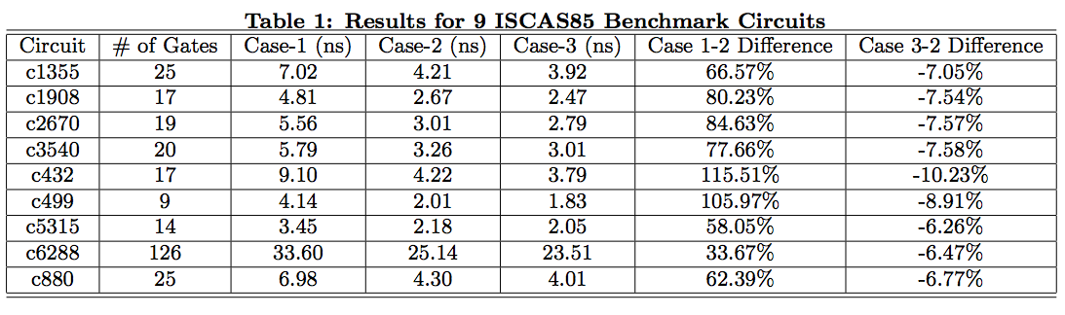
Critical Path Not A Static Value!
The cases that have lower temperature have smaller worst-case delays
Voltage can also affect delays
Source: Critical Path Analysis Considering Temperature, Power Supply Variations and Temperature Induced Leakage by Li (Texas A&M)

Slide 11
Process Variation Also Complicates Things
Not all chips on a given wafer are equal
  Maximum frequency, voltage level, power consumption can differ
    Especially true when things get smaller
  Critical path may be different from chip to chip
  This leads to frequency binning
    Companies may even sell a 6-core chip as a quad core chip
    Very hard to get all 6 cores to meet standards, better chance for 4 cores
  Maximum clock frequency is usually underestimated
    That’s why you can overclock your processor

Slide 12
C To Gates
Sometimes, C-like code is easier to understand/create than an HLSM
Inputs
: A, B [256](8 bits); go (bit)
C code
Outputs
: sad (32 bits)
Local storage
: sum, sadreg (32 bits); i (9 bits)
i
n
t SAD (byte A[256], byte B[256]) // not quite C syntax
S0
!go
{
go
uint sum; short uint I;
sum := 0
sum = 0;
S1
i := 0
i = 0;
while (i < 256) {
S2
sum = sum + abs(A[i] – B[i]);
i<256
i = i + 1;
(i<256)’
S3
sum:=sum+abs(A[i]-B[i])
}
i := i + 1
return sum;
}
S4
sadreg := sum

Slide 13
Conversion From C to HLSM
Often used statements in C
  Assignment statements
    Example: sum = 0;
  If/else statements
  While/for loops
Idea
  Have an HLSM template for each of these statements and apply it as needed

Slide 14
Converting From C To HLSM
Assignment statement
  Becomes one state with assignment
If-then statement
  Becomes state with condition check, transitioning to “then” statements if condition true, otherwise to ending state
  “then” statements would also be converted to states
target = expression;
target :=
expression
cond’
if (cond) {
cond
// then stmts
(then stmts)
}
(end)

Slide 15
Converting From C To HLSM
If-then-else
  Becomes state with condition check, transitioning to “then” statements if condition true, or to “else” statements if condition false
While loop statement
  Becomes state with condition check, transitioning to while loop’s statements if true, then transitioning back to condition check
cond’
if (cond) {
cond
// then stmts
(then stmts)
(else stmts)
}
else {
// else stmts
(end)
}
cond’
while (cond) {
cond
// while stmts
(while stmts)
}
(end)

Slide 16


Simple Example
Simple example: Computing the minimum of two numbers
  Convert if-then-else statement to states
  Then convert assignment statements
Inputs: uint X, Y
Outputs: uint Min
(X<Y)’
(X<Y)’
X<Y
X<Y
if (X < Y) {
Min = X;
(then stmts)
(else stmts)
Min:=X
Min:=Y
}
else {
Min = Y;
(end)
(end)
}

Slide 17
Your Turn!
while (a != b) {
  if (a > b) {
    a = a – b;
  }
  else {
    b = b – a;
  }
}
target = expression;
target :=
expression
if (cond) {
// then stmts
cond’
}
cond
else {
(then stmts)
(else stmts)
// else stmts
}
(end)
cond’
while (cond) {
cond
// while stmts
(while stmts)
}
(end)

Slide 18
Today’s Objectives
To understand how to use a timer to control a high-level state machine
To understand how the clock period is related to RTL design
  To know how to determine the minimum clock period for a given design
    (Maximum clock frequency)
To become familiar with techniques to convert C-like code into an HLSM

Slide 19
Question
Exercise 5.22 in main textbook

